Slide 1
Introduction to Programming
Lecture 2

Slide 2


Important
“Tell me and I will forget.
Teach me and I remember.
Involve me and I learn.”
Benjamin Franklin
Always bring a neat Sheet of paper and a pencil/pen with you to the lecture.

Slide 3
Agenda
Using Break and Continue within loops
Arrays

Slide 4
Using Break and Continue within loops

Slide 5
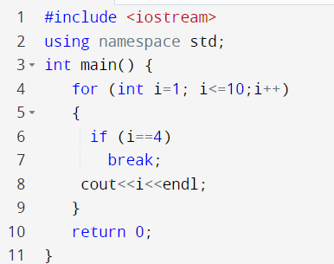
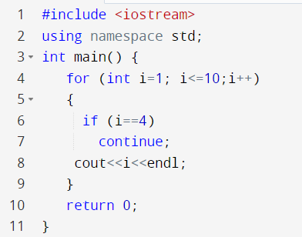



Break versus Continue
Break
Continue
Break statement stops the entire process of the loop.
Continue statement stops only the current iteration

Slide 6
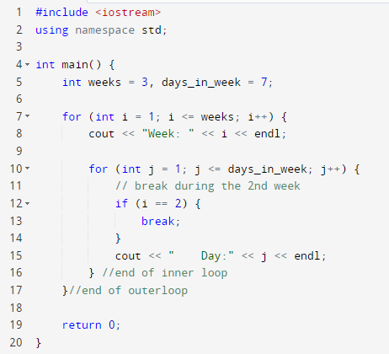

Break inside inner loop
When we use a break statement inside the inner loop, it terminates the inner loop but not the outer loop.
← i for weeks
← j for days

Slide 7
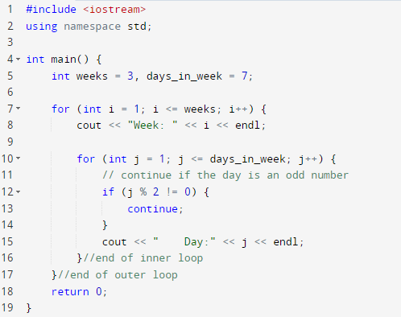
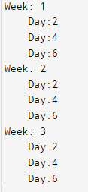
Continue inside inner loop
When we use a continue statement inside the inner loop, it skips the current iteration of the inner loop only. The outer loop is unaffected.
← i for weeks
← j for days

Slide 8
Arrays

Slide 9


Arrays
What if I need to store all your names in variables in my program??
Do I have to declare 400 string variables?
string name1 = “Ahmed Ali”;
string name2 = “Mona Salah”;
string name3 = “Karim Shawki”;
And so on – 400 times
Arrays will save us

Slide 10
Arrays
An Array is used to store multiple values in a single variable, instead of declaring separate variables for each value.
An Array is a collection of items of the same data type.
How to declare an array of strings?
string names [400];
string cars[5];
You reserved 5 places in the memory, each one of them could store a string

Slide 11
Declaring and Initializing an array
To declare an array, define the variable type, specify the name of the array followed by square brackets , and specify the number of elements it should store.
string cars[5];
Initializing your array:
You could initialize your array with values once you create it, and you could change the value later if you want.
string cars[5] = {"Volvo", "BMW", "Ford", "Mazda", “Toyota" };
Volvo | BMW | Ford | Mazda | Toyota

Slide 12
Accessing an Array element
How to access an element from the array?
string cars[5] = {"Volvo", "BMW", "Ford", "Mazda", “Toyota" };
Each element has an Index.
0 | 1 | 2 | 3 | 4
Volvo | BMW | Ford | Mazda | Toyota
The first element is at index 0.
The last element is at index size of the array-1.

Slide 13
Accessing an Array element
Array Indexes
0 | 1 | 2 | 3 | 4
Volvo | BMW | Ford | Mazda | Toyota
Array Elements
cout<<cars[0];
Volvo
How to modify an element of an array?
cars[0] = "Nissan";
cout<<cars[0];
Nissan
0 | 1 | 2 | 3 | 4
Nissan | BMW | Ford | Mazda | Toyota

Slide 14

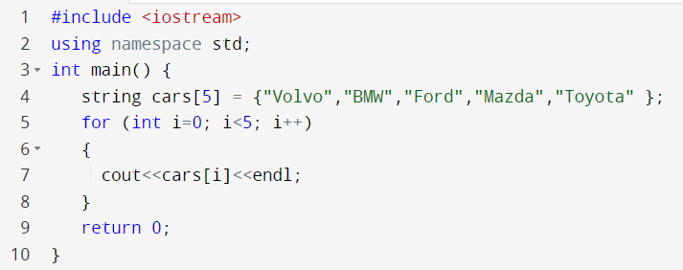
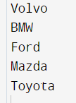


Printing an Array
Do I have to cout each element in an array in a separate statement?
Just use a for loop to pass by the indexes
The last index must be array size -1
0 | 1 | 2 | 3 | 4
Volvo | BMW | Ford | Mazda | Toyota

Slide 15
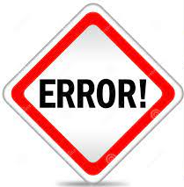
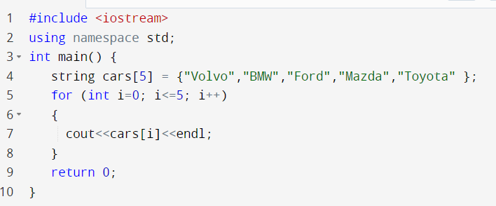
Printing an Array
You will get Array out of boundaries error if you try to access an index more than the array size -1
The last index must be array size -1
0 | 1 | 2 | 3 | 4
Volvo | BMW | Ford | Mazda | Toyota

Slide 16
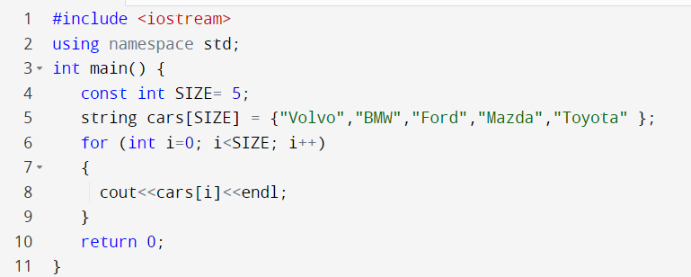
Good Programmer Tip

Slide 17
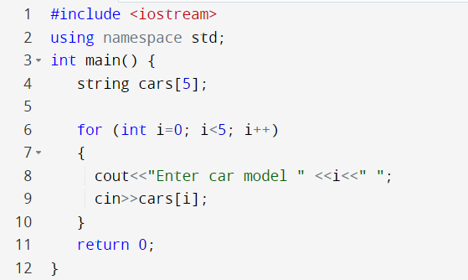
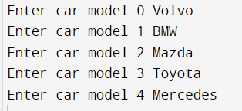
Filling an Array with elements from user

Slide 18

Examples

Slide 19
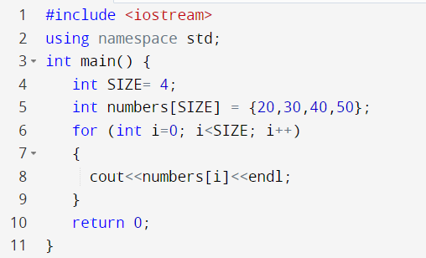

Example 1: Array of int

Slide 20
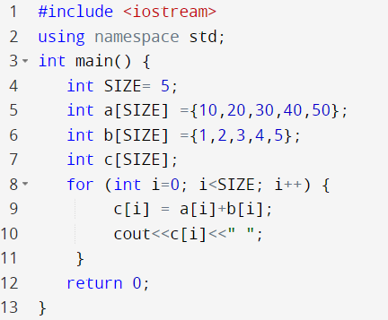
Example 2: Array of int
Problem: Given two arrays of int, both of the same length. Your program should add the numbers of the same index from both arrays, store the result at the same index in a third array, and print it out.
0 | 1 | 2 | 3 | 4
10 | 20 | 30 | 40 | 50
a
0 | 1 | 2 | 3 | 4
1 | 2 | 3 | 4 | 5
b
0 | 1 | 2 | 3 | 4
11 | 22 | 33 | 44 | 55
c

Slide 21
Declaring and Initializing an Array
The impact of different declaring and initialization on the output
 | Output from printing the array
int numbers[]; | Random values
int numbers[5] = {20,30}; | 20 30 0 0 0
int numbers[5] = {}; | 0 0 0 0 0
float numbers[]; | Random values
float numbers[5] = {20,30}; | 20 30 0 0 0
float numbers[5] = {}; | 0 0 0 0 0
bool flags[5]; | Random values
bool flags[5]= {}; | 0 0 0 0 0 //0 if false and 1 is true
Bool flags[5]={1,1}; | 1 1 0 0 0

Slide 22
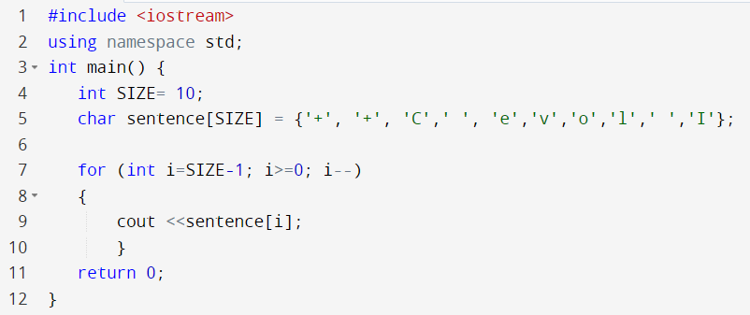


Example 3: Array of char
Problem: Given an Array of characters as stated below, print the array in reverse order.
i=9
char sentence[10] = {'+', '+', 'C',' ', 'e','v','o',’l',' ','I'};
0 | 1 | 2 | 3 | 4 | 5 | 6 | 7 | 8 | 9
+ | + | C |  | e | v | o | l |  | I

Slide 23
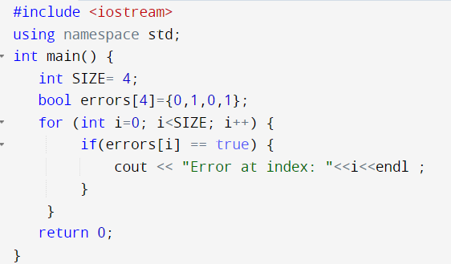

Example 4: Array of booleans
Problem: Given an Array of boolean values representing the existence of errors, print the index where the error value is true.

Slide 24

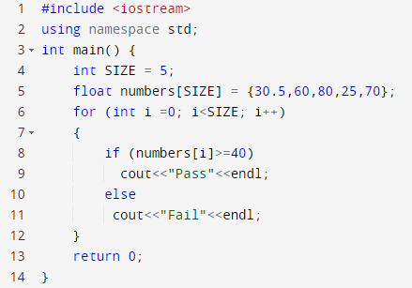

Example 5
Problem: Declare an array of 5 numbers, each number represents student grades. Pass by the array, and print “Pass” if the grade is greater than or equal to 40. Print “Fail” if the grade is less than 40.

Slide 25
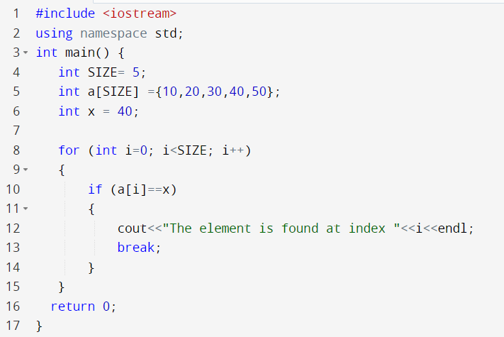
Example 6: Searching an Array
Problem: Given an Array of int values, and a number to search for within the array. Write a program to search for the number within the array. If the number is found, print the index.
x=40
Compare x with each array element
0 | 1 | 2 | 3 | 4
10 | 20 | 30 | 40 | 50

Slide 26
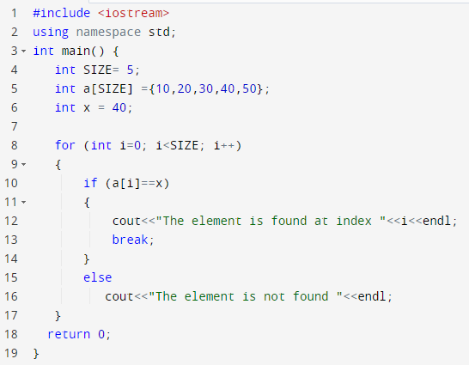


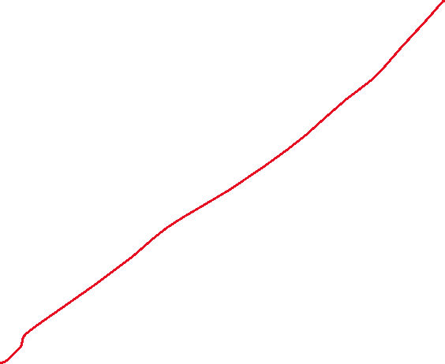
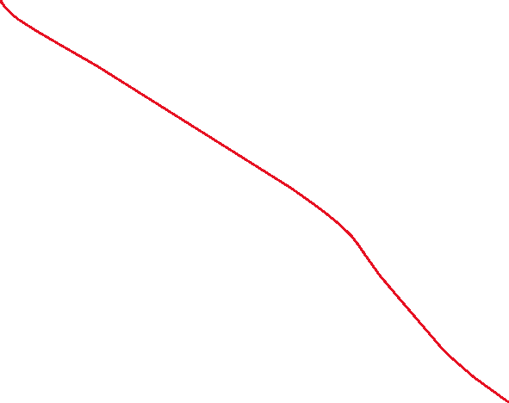
Example 6 (continued)
Problem: Extend the previous example of searching an array to print that the element is not found.

Slide 27
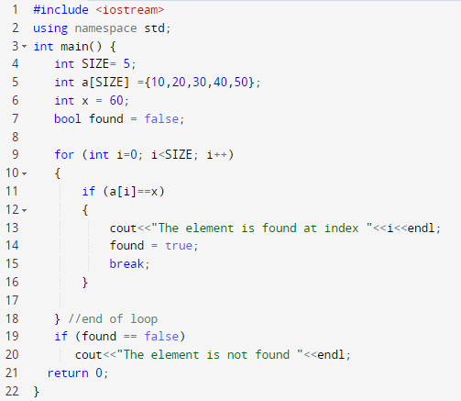
Example 6 (continued)
Problem: Extend the previous example of searching an array to print that the element is not found.

Slide 28
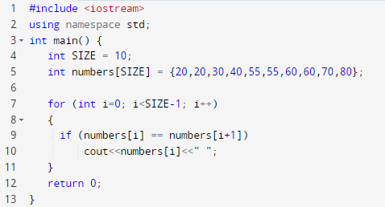

Example 7: Checking adjacent elements equality
Problem: Given an Array of int values, and a number to search for within the array. Write a program to print only the numbers if found to be equal number with its adjacent cell.

Slide 29
Example 8: switch with arrays
In a supermarket, assume a user would buy 5 items from the following products shown in the table below. Write a program where the user enters the 5 items as characters. The program should store the products in an array and the program calculates and prints out the total bill.
Product | User input | Price per item
Yogurt | ‘Y’ or ‘y’ | 5
Coffee | ‘C’ or ‘c’ | 200
Tea | ‘T’ or ‘t’ | 30
Milk | ‘M’ or ‘m’ | 45

Slide 30
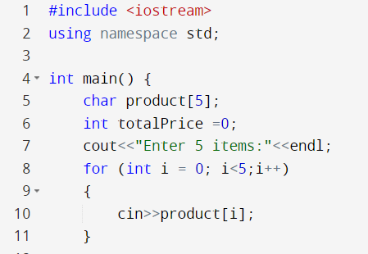
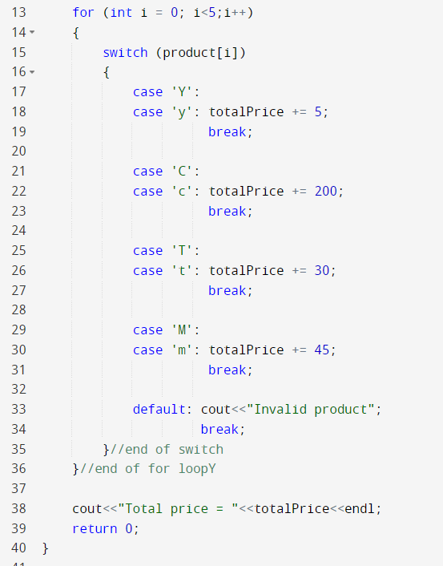
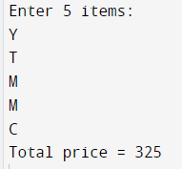
Example 8: switch with arrays

Slide 31

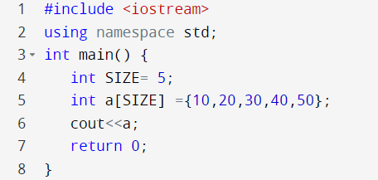

Keep in mind for later
The array variable is a reference to its location in memory
A hexadecimal number representing the reference of an array (its location in memory)
a = 0x7ffeb1308890

Slide 32

Thank You

